Slide 1
STDF Analyze Report
Editor : Arkhan, Nick
Date : 2014/03/24

Slide 2
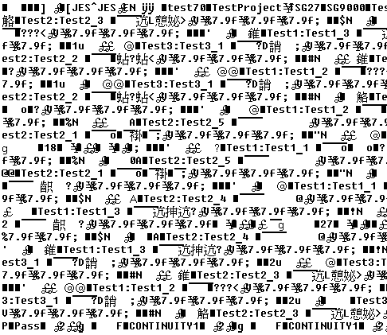
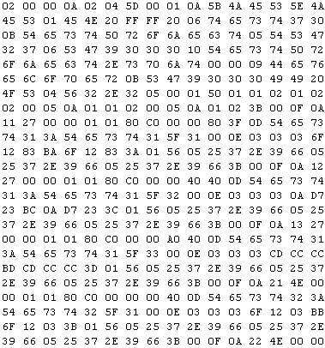
Standard Test Data Format (Binary File I/O)
Use Notepad to see the STDF FILE
Use UltraEdit to see the STDF FILE
To analyze STDF File, we need to know files data Architecture.

Slide 3
Binary File Benefit
Speed I/O
File size
Read
Read
ASCII
ASCII to Binary
Memory
Binary to ASCII
HDD
File
Write
Write
Read
Read
Binary
Memory
HDD
Fast
Write
Write
File
 | ASCII | Binary
Number 2014 | 50, 48, 49, 52 | 7DE
Size | 4 Byte | 2 Byte
Small

Slide 4
STDF File Data Architecture
FAR (File must contain)
MIR (File must contain)
SDR
PIR
PTR
PRR
‧ ‧ ‧
PIR
PTR
PRR
TSR
HBR
SBR
PCR (File must contain)
MRR (File must contain)
Location of the Record must followed the rule of STDF File spec..
The first record in the STDF file must be the FAR (file attributes record).
Teradyne has been defined codes(Dec) to distinguish all of the records and saved data. (ex : FAR, 0 10)
For analyze the record, we need know the code and data length under record.
Basic Structure for STDF File

Slide 5
STDF File Record Structure
Record Code
Record Name | Record Header |  |  | Data Fields
 | Record_LEN | Record_TYPE | Record_SUB
FAR | Depend on data length | 0 | 10 | many field information
MIR | Depend on data length | 1 | 10 | many field information
SDR | Depend on data length | 1 | 80 | many field information
PIR | Depend on data length | 5 | 10 | many field information
PTR | Depend on data length | 15 | 10 | many field information
PRR | Depend on data length | 5 | 20 | many field information
TSR | Depend on data length | 10 | 30 | many field information
HBR | Depend on data length | 1 | 40 | many field information
SBR | Depend on data length | 1 | 50 | many field information
PCR | Depend on data length | 1 | 30 | many field information
MRR | Depend on data length | 1 | 20 | many field information
Data collected on a per lot basis

Slide 6
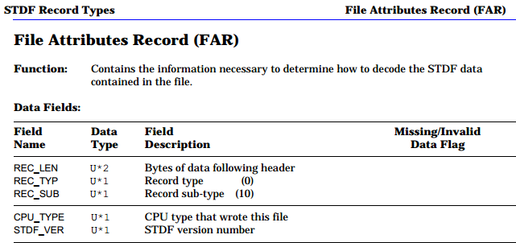
FAR Spec
4 Byte
Means Fields input how many bytes in STDF File.

Slide 7
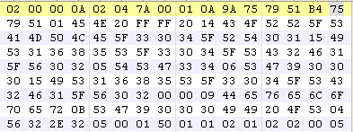
Example for Read FAR (Find Record Information)
Record Header (4 Byte)
DATA
CPU_TYPE : 2 ( 1 Byte)
STDFVER : 4 ( 1 Byte )
REC_LEN( 2 BYTE )
REC_TYP( 1 BYTE )
REC_SUB( 1 BYTE )
All of the Record Header take 4Byte Length (REC_LEN : 2 Byte, REC_TYP : 1Byte, REC_SUB : 1Byte)
2. See the example, REC_TYP = 00h(0) and REC_SUB = 0Ah(10) means
reading FAR, REC_LEN = 0002h(2) means DATA Length has 2 Byte.

Slide 8
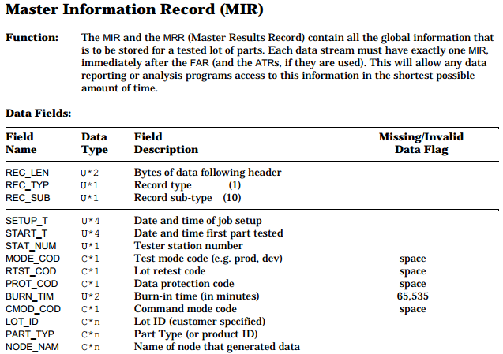
MIR Spec
C*n Data Type

Slide 9
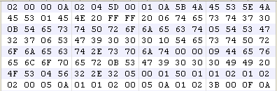
Example for Read MIR (Solve C*n Data Type)
LOD_ID Field
Record Header
LOT_ID (LOT_ID Length Byte)
OPER_NAM
MIR
LOT_ID Length (1 Byte)
JOB_REV Length (1 Byte)
CMOD_COD
SBLOT_ID Length (1 Byte)
If Data Type are C*n (LOT_ID Field), the first Byte is Field Length, then read Field Length Byte to get field data.
If Field Length equal to 0 (example for JOB_REV&SBLOT_ID), automatic jump to next Field.

Slide 10
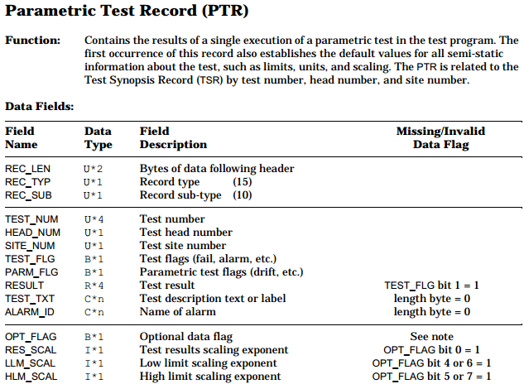
PTR Spec
Boolean Data Type

Slide 11

Example for Read PTR (Solve Boolean Data Type)
Record Header
TEST_FLG Field
(Data TYPE : 8Bit Boolean)
PARM_FLG Field
(Data TYPE : 8Bit Boolean)
PTR
TEST_FLG = 80h :
If Data Type are Boolean (TEST_FLG & PARM_FLG), the value must be translated by 8bit (two binary combination) to analyze.
Every bit number contains the test data after test (see spec).
bit7 | bit6 | bit5 | bit4 | bit3 | bit2 | bit1 | bit0
8 | 4 | 2 | 1 | 8 | 4 | 2 | 1
1 | 0 | 0 | 0 | 0 | 0 | 0 | 0
8 |  |  |  | 0

Slide 12
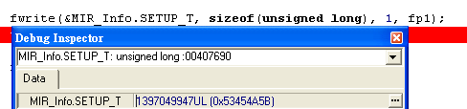

Prepare for programing STDF File
Big endian and Little endian
  Normal Hex value arrangement are Big to Little endian
  Example: 1397049947(Dec) to 4 Byte Hex 53 45 4A 5B
  Write 4 Byte Hex 53 45 4A 5B to Binary File
  Binary file will change 4 Byte Hex to 5B 4A 45 53 (Little to Big)
Binary File Show 5B 4A 45 53
Write 4 Byte Hex 53 45 4A 5B to Binary

Slide 13
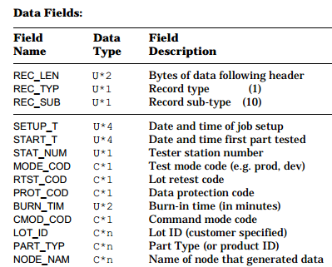
In Read/Write STD File, must know the fields take how many byte length.
Data Type | C Type
U*1 | Char
U*2 | Unisgned short
U*4 | Unisgned long
C*n | Char[]
B*n | Char[]
I*2 | Short int
R*4 | float
Define correspond Type to the program variables

Slide 14
In read STD File, check the current length whether equal to REC_LEN, if current Length equal to REC_LEN, read next Record.
  Example :
Correct :
Field | cur_len≠rec_len | ‧‧‧ | Field | cur_len≠rec_len | Field | cur_len=rec_len | Field
Record1
Record2
Incorrect :
Field | Field | ‧‧‧ | Field | Field | Field | ‧‧‧ | Field
Record1
Record2

Slide 15
STDF Struct Define
Record Header Define
Struct RecordHeader
{
unsigned short REC_LEN;
unsigned char REC_TYP;
unsigned char REC_SUB;
};

Slide 16
Record Define
Struct RecordName // Changed by RecordName
{
struct RecordHeader RecordHeader; // fixed
‧
‧ // Add Record Variable
‧
};
RecordName RecordName;

Slide 17
Example for Struct Record Define
Record Name : FAR
Struct RecordFAR // Changed by RecordName
{
struct RecordHeader RecordHeader; // fixed
unsigned char CPU_TYP; // FAR Variable
unsigned char STDF_VER; // FAR Variable
};
RecordFAR RecordFAR;

Slide 18
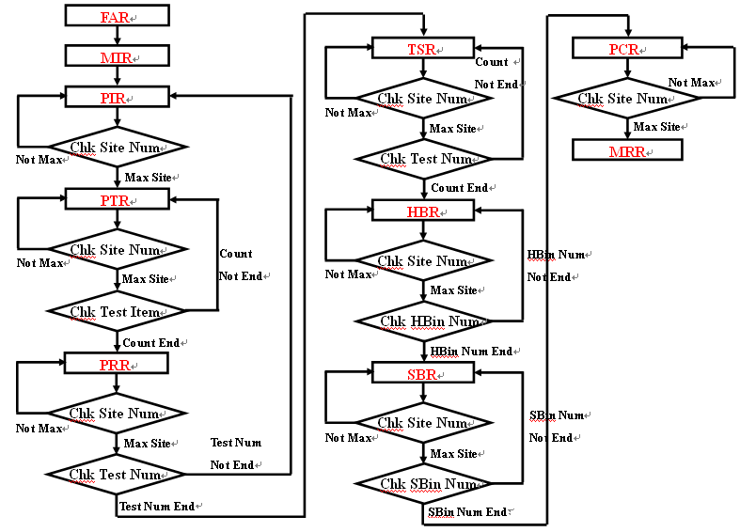
STDF Processing Flow Chart

Slide 19
Conclusion
  Analyze Binary file need know data define, data length.
  In program, need know how to use fread/fwrite/fsetpos/fgetpos
Reference
  STDF Spec(http://etidweb.tamu.edu/cdrom0/image/stdf/spec.pdf)
  ATE系统的結構分析與數據管理優化(http://www.doc88.com/p-534463439880.html)
  Value translate(http://www.convertworld.com/zh-Hant/numerals/%E5%8D%81%E5%85%AD%E9%80%B2%E5%88%B6.html)
  Ascii (http://zh.wikipedia.org/wiki/ASCII)

